Slide 1

Escort
Journey of a thousand miles begins with a single step...

Slide 2
PROJECT TEAM MEMBERS :
V RAVINDRA NATH : 20010-CM-118
N NARENDRA : 20010-CM-087
TSVNN PAVAN SAI : 20010-CM-114
V SIDDU NAYAK : 20010-CM-120
R MEGHANADH : 20010-CM-100
M TEJASWINI : 20010-CM-078
J YASASVEE : 20010-CM-134
K RAMYA SRI : 20010-CM-067
T NAVYA SAI : 20010-CM-115

Slide 3
INTRODUCTION
OUR PROJECT Is ESCORT . It is a website about TOURISM GUIDE .
Our website helps the tourists to locate the Famous Tourist Places in the
Selected Location. Tourists can search famous Restaurants and
Hotels according to their tourist place . By Using this website Tourists can get
All Information regarding to that place ...

Slide 4
ABSTRACT
This project is on the most beautiful places in India. It is a website which presents all information about different places in India. Information like hotels, restaurants, popular visiting places. This website guides everyone to visit the tourist places. It is just like tourist guide. Smart phones are growing exponentially and become popular to offer greater services to users like GPS navigation, web navigation, games and more. This encourages the developers to build new applications which the user can be use it easily through this hand-held device.
The user can get the information from via a web browser through internet.

Slide 5




LANGUAGES USED
-> HTML [HYPER TEXT MARKUP LANGUAGE]
-> CSS [CASCADING STYLE SHEETS]
-> JAVA SCRIPT
-> DATA BASE BY NETLIFY

Slide 6
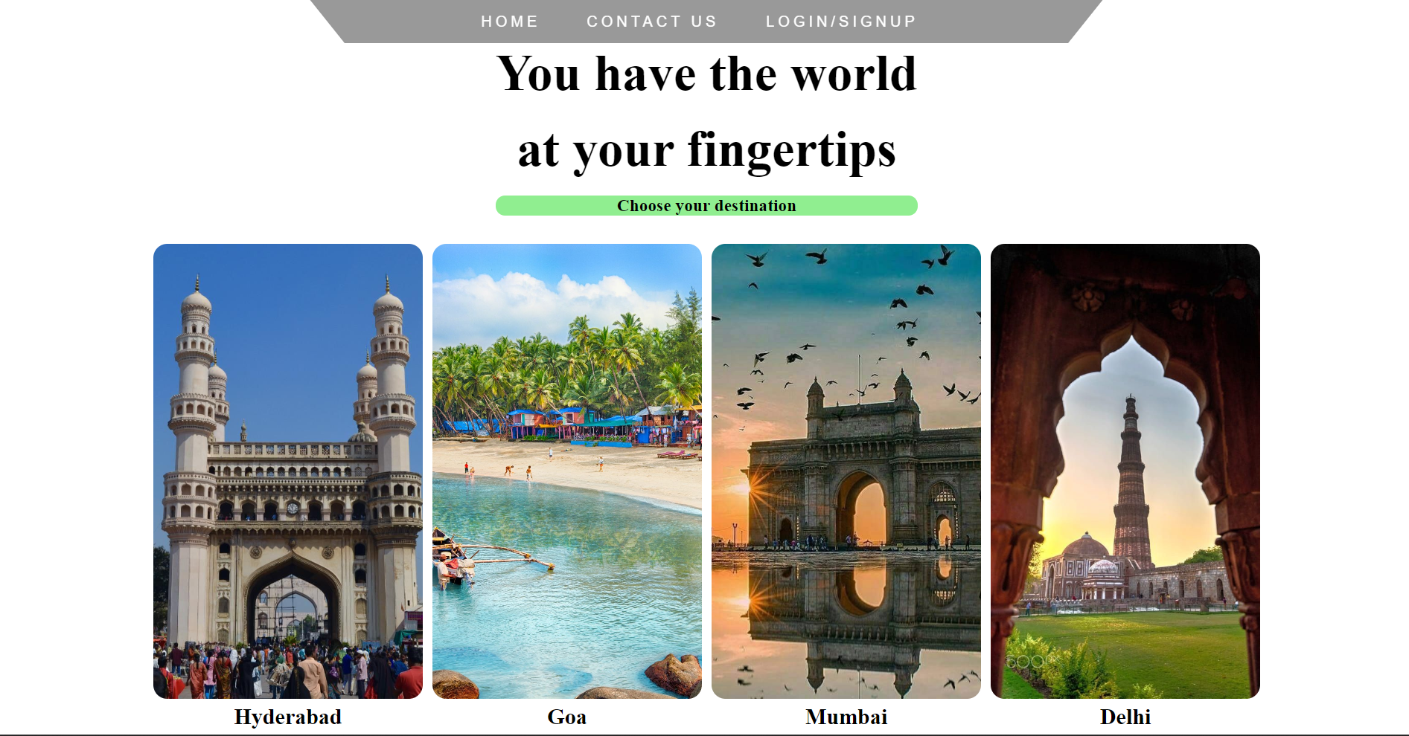
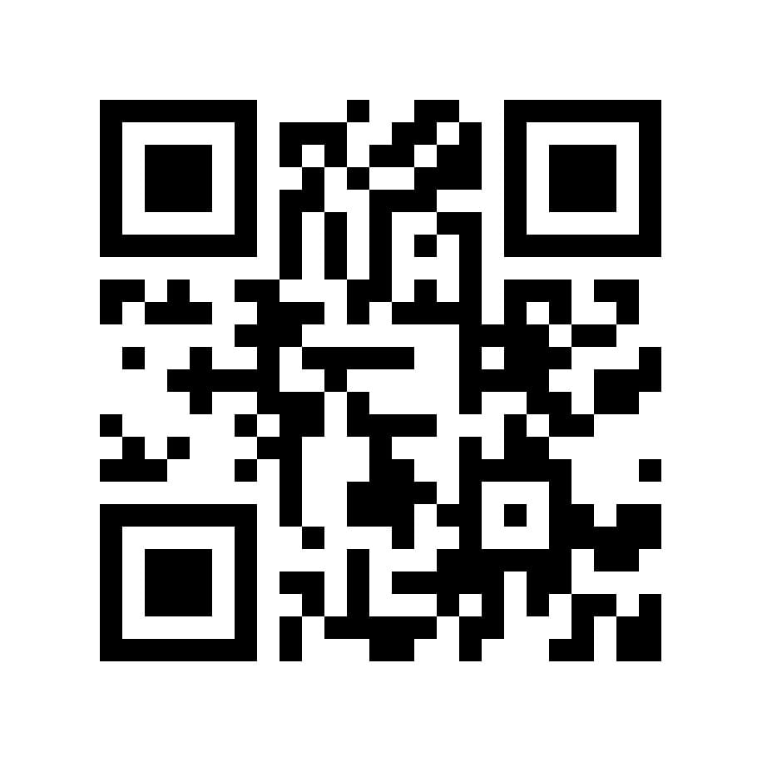
AFTER CLICKING ON THIS LINK ESCORT YOU WILL BE NAVIGATED TO
OUR HOMEPAGE
(OR)
BY SCANING THE ABOVE GIVEN QRCODE ALSO YOU WILL BE NAVIGATED
TO OUR HOMEPAGE
STEP1 :
ESCORT

Slide 7
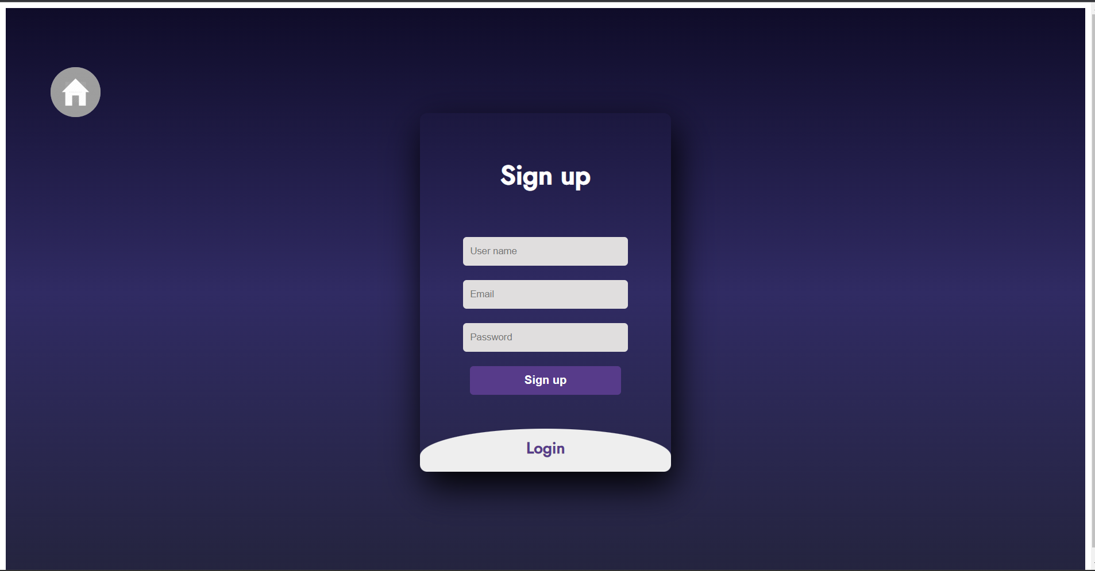
First user need to create an account to use our services
User can create an new account with his Email
Password is required for users privacy
If User already have an account . User can login with his Email ID and Password by clicking login button
LOGIN Button given below

Slide 8
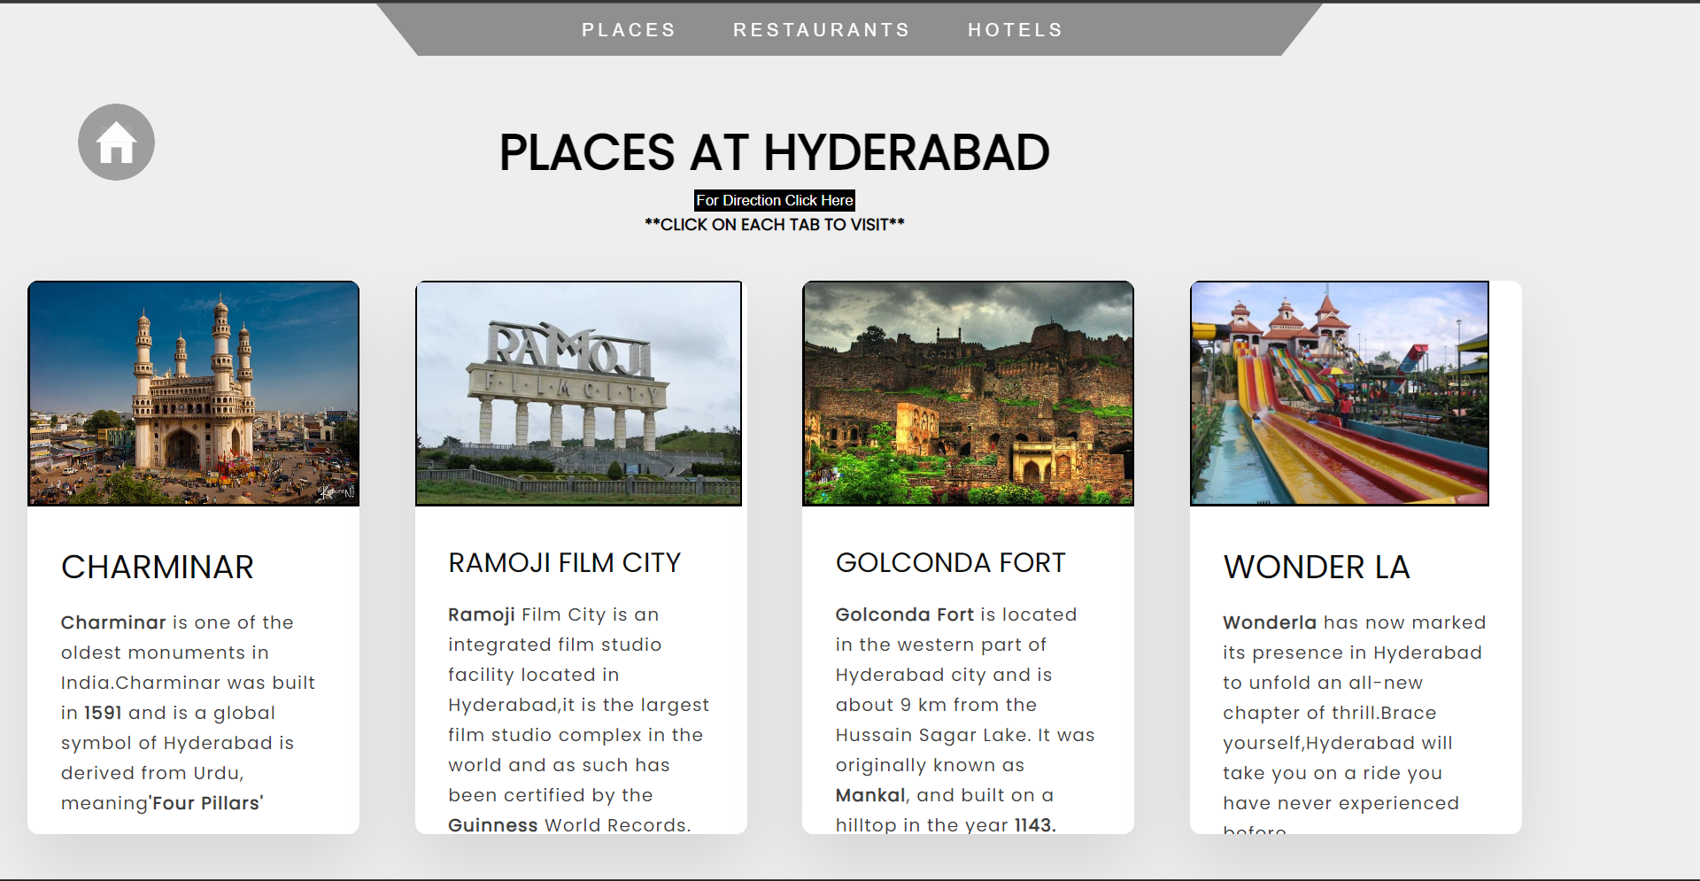
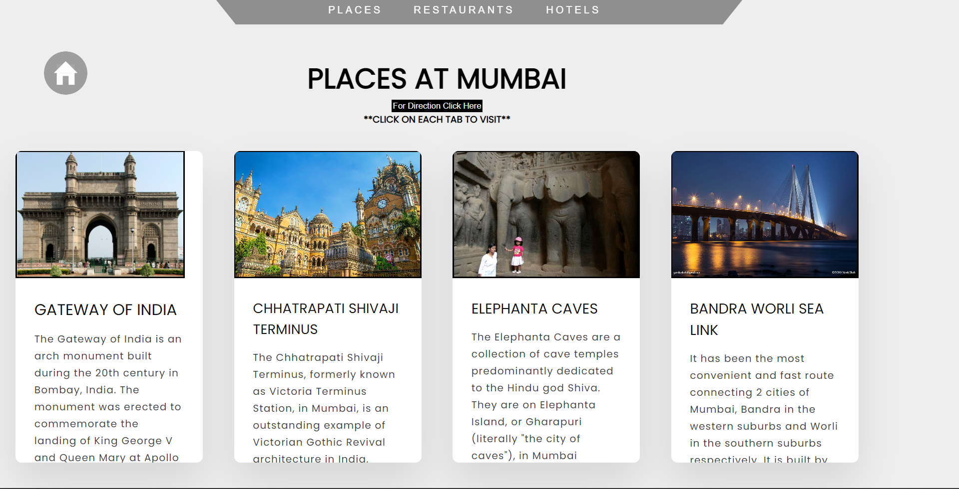
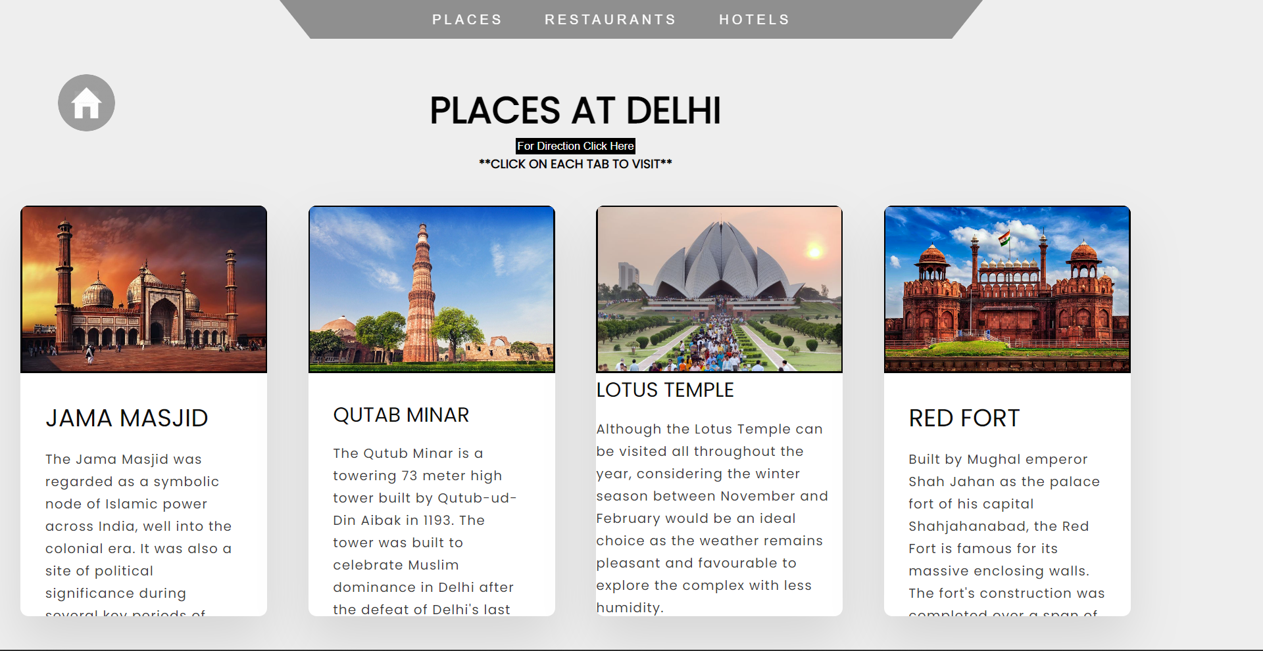
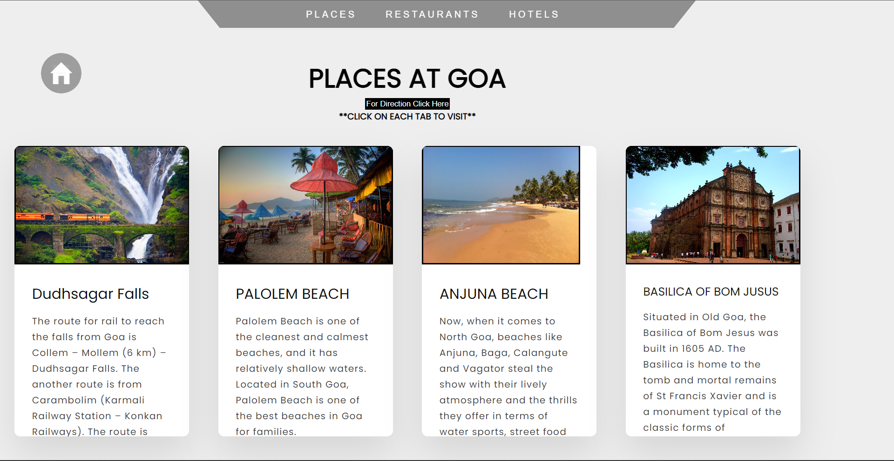
Tourist Places in Hyderabad
Tourist Places in Mumbai
After selecting the Destination in Home page , All the tourist places in that destination will be Appeared on the screen
And we can navigate to that location by clicking on the button "FOR DIRECTIONS CLICK HERE"
Tourist Places in Goa
Tourist Places in Delhi

Slide 9
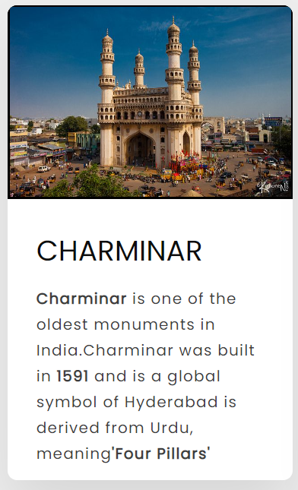
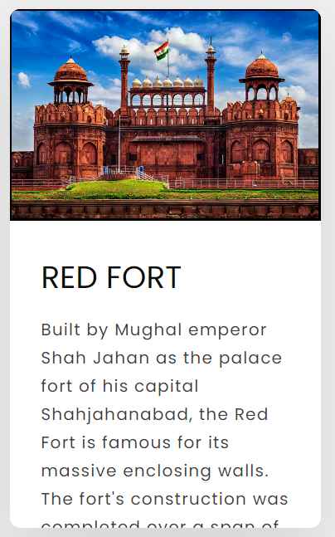
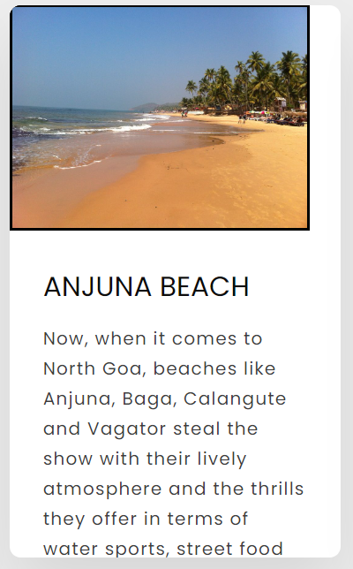
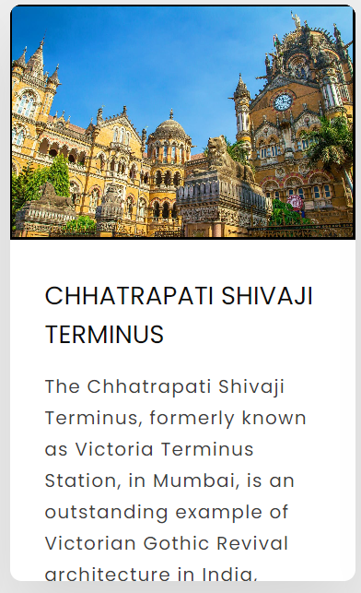
After selecting the Destination . All the Famous places are shown with its History
There user can see its Brief Details
When user click on the Tab it will show the location of the Respective Tourist Spot

Slide 10
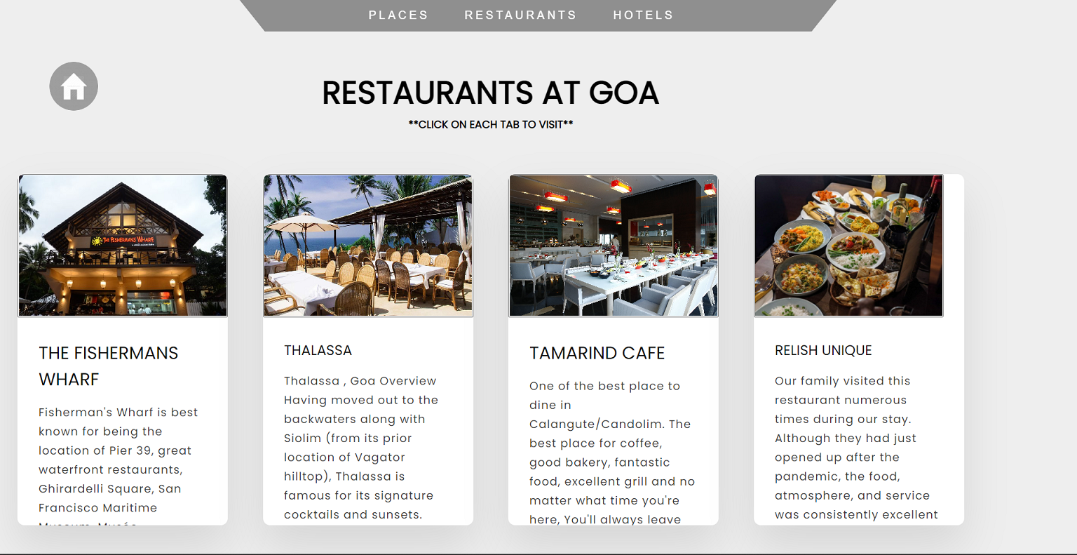
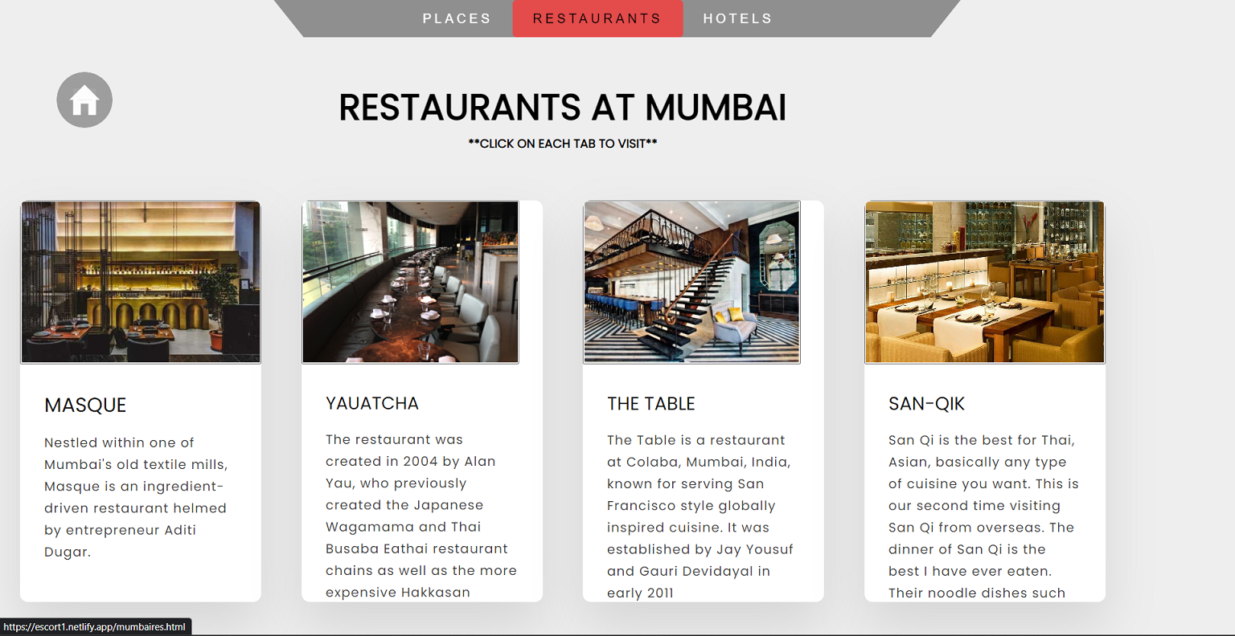
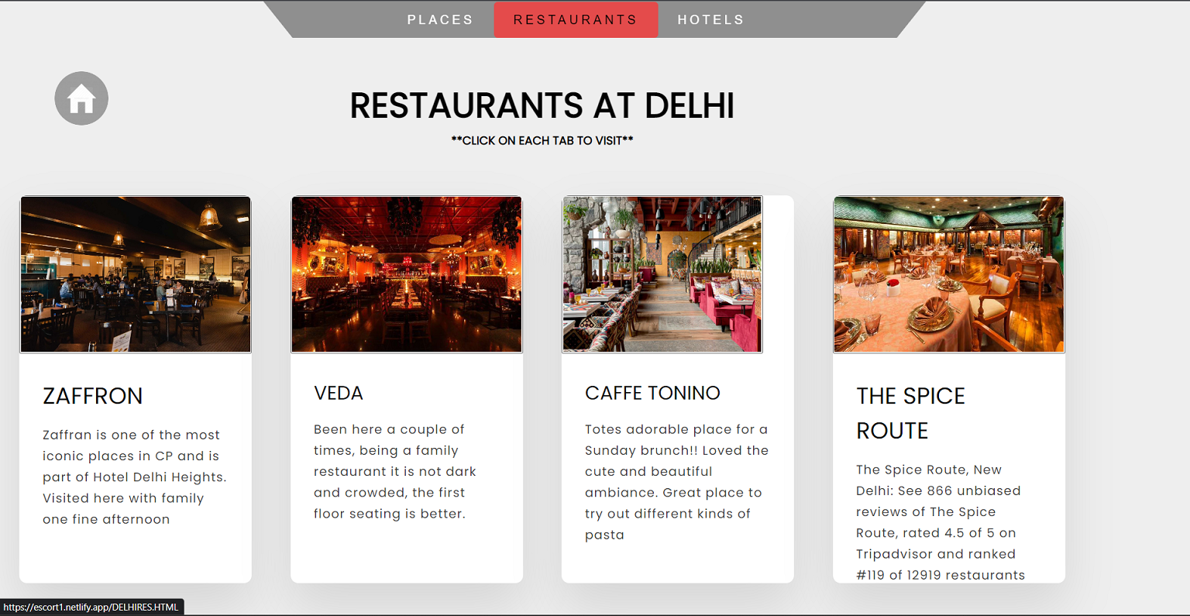
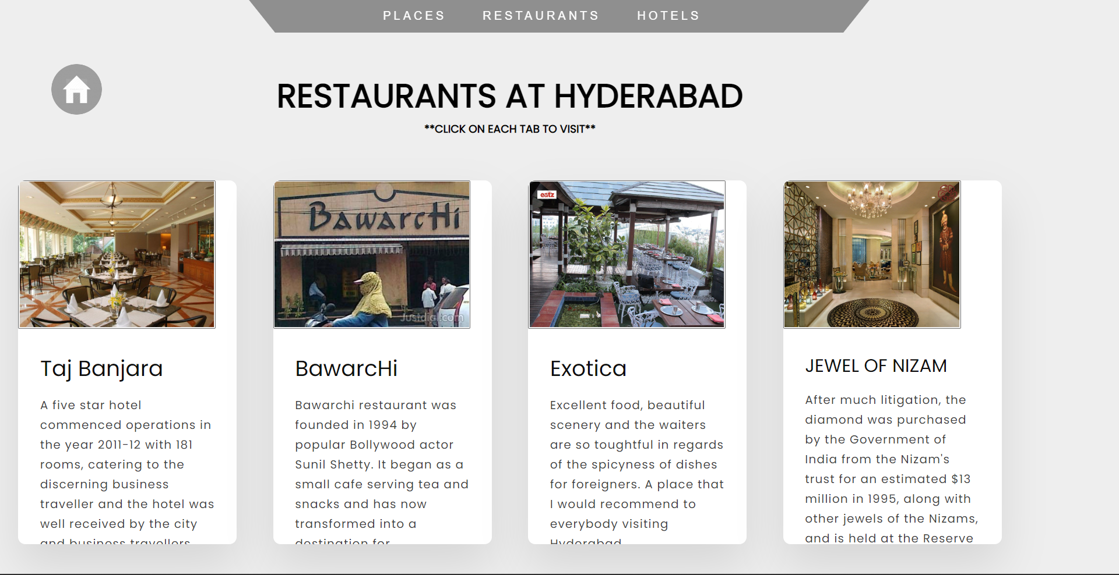
Restaurants in Goa
Restaurants in Mumbai
After selecting the Destination in Home page ,
All the tourist places in that destination will be Appeared on the screen
On the title bar you can see Restaurants . By clicking on it , you can see Restaurants in each place like this.
For the location click on desired tab.
Restaurants in Hyderabad
Restaurants in Delhi

Slide 11
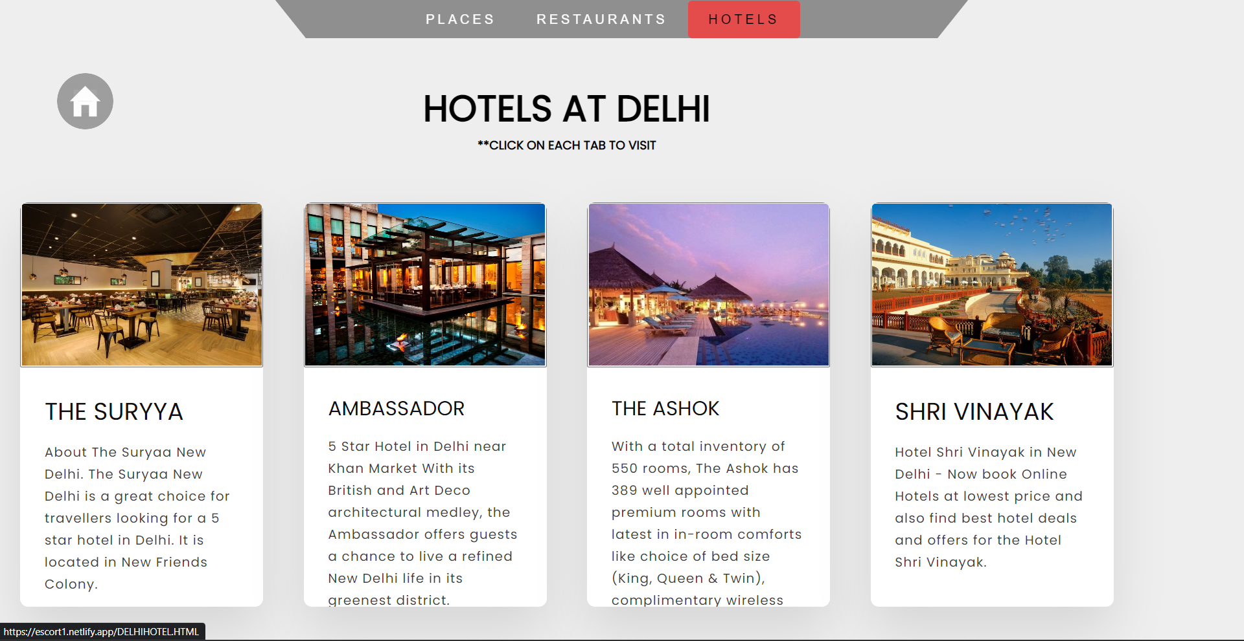
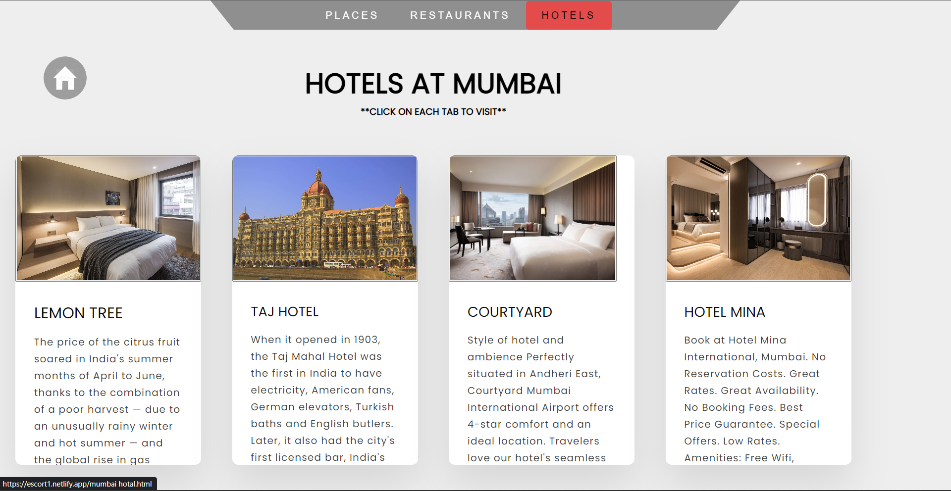
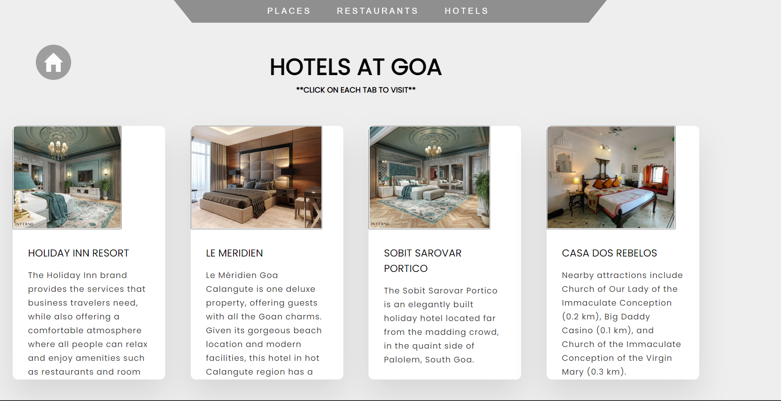
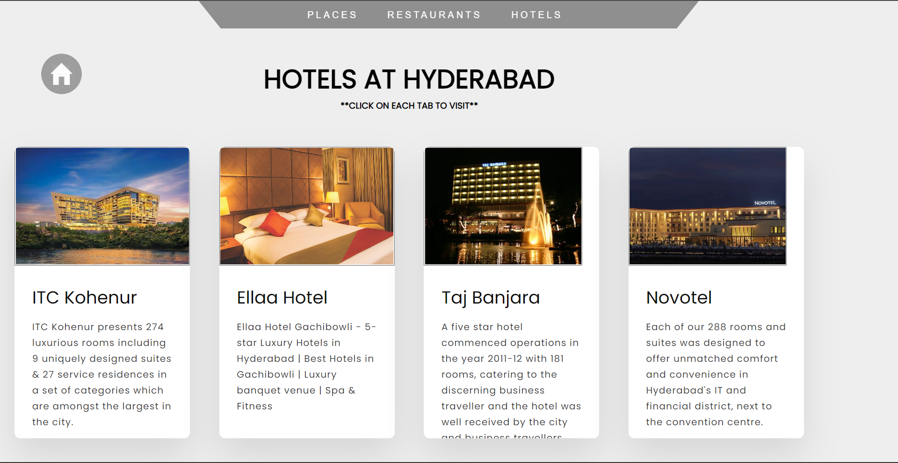
Hotels in Delhi
Hotels in Mumbai
After selecting the Destination in Home page
On the title bar you can see Hotels . By clicking on it , you can see Hotels in each place like this.
For the location click on desired tab.
Hotels in Hyderabad
Hotels in Goa

Slide 12

By clicking on above given icon in Web site , It takes you to the homepage

Slide 13
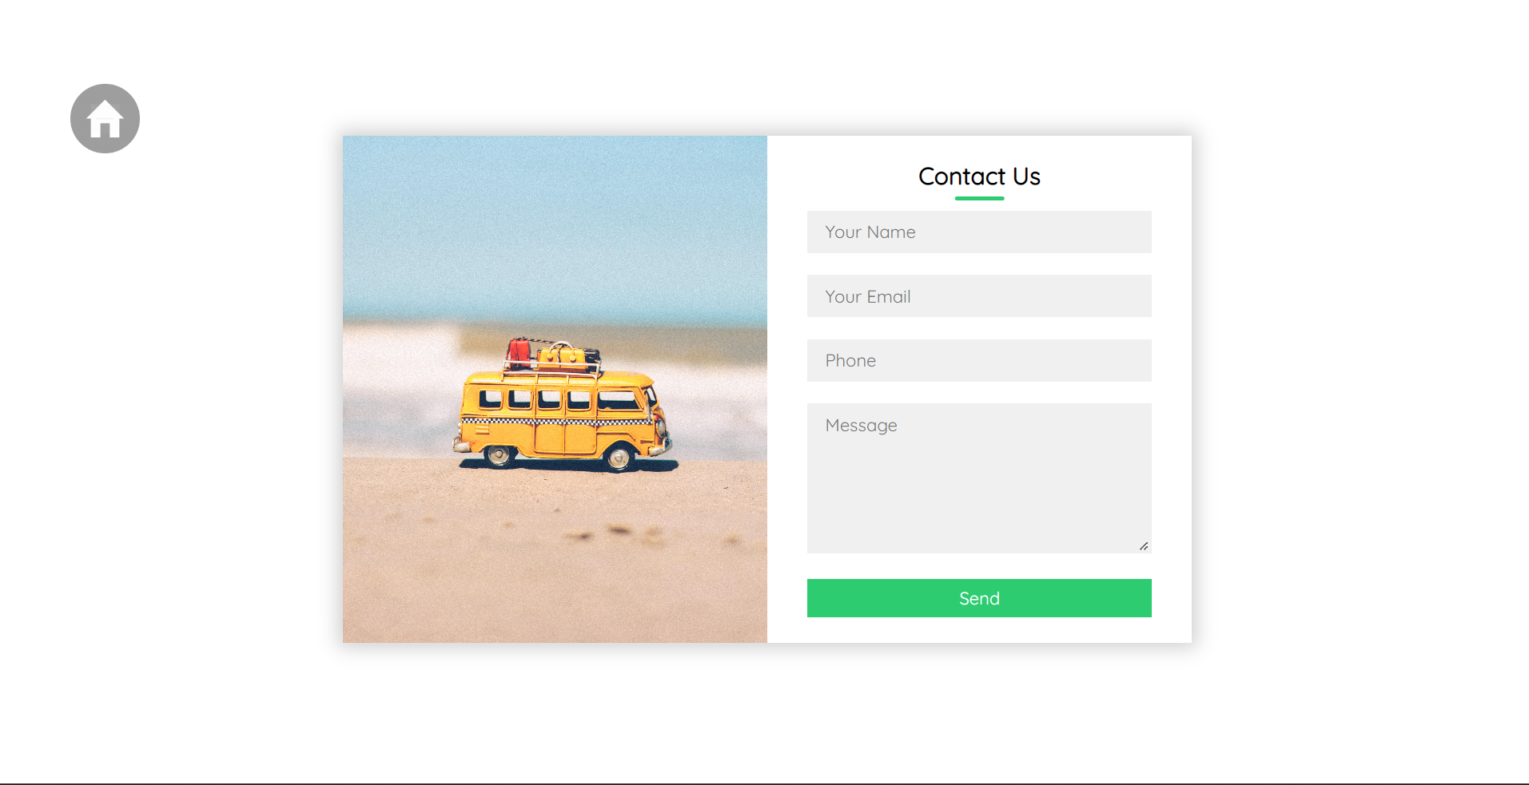

If user face any issue regarding our website they can contact us by entering their info in above form

Slide 14
THANK YOU
TO OUR GUIDE
K LAKSHMI DEVI MAM

